Slide 1

The Battle of Neighborhoods - To Find a Better Place in Scarborough, Toronto

Slide 2

Introduction
The purpose of this Project is to help people in exploring better facilities around their neighbourhood. It will help people making smart and efficient decision on selecting great neighbourhood out of numbers of other neighbourhoods in Scarborough, Toronto.
Lots of people are migrating to various states of Canada and needed lots of research for good housing prices and reputed schools for their children. This project is for those people who are looking for better neighbourhoods. For ease of accessing to Cafe, School, Supermarket, medical shops, grocery shops, mall, theatre, hospital, likeminded people, etc.

Slide 3
Data Section
DataLink: https://en.wikipedia.org/wiki/List_of_postal_codes_of_Canada:_M
Will use Scarborough dataset which we scrapped from Wikipedia on Week 3. Dataset consisting of latitude and longitude, zip codes.

Slide 4
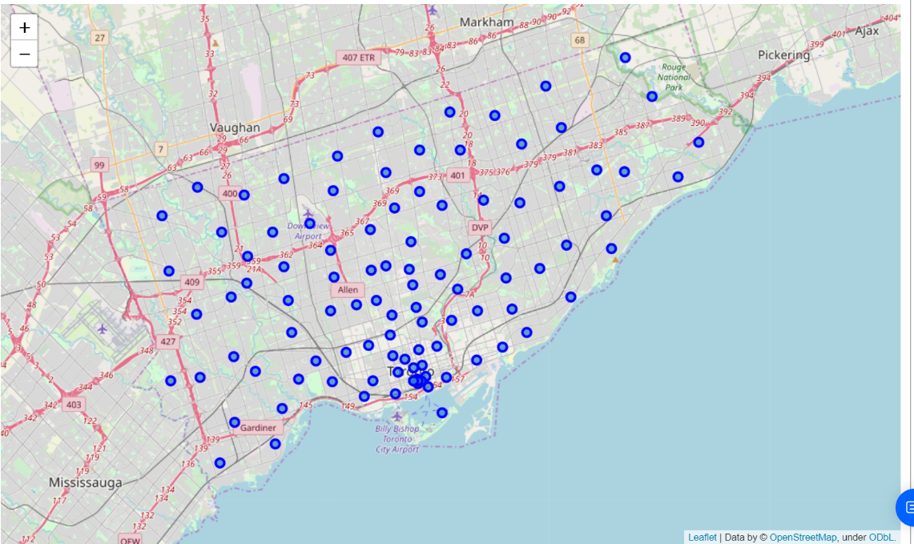
Map of Scarborough

Slide 5

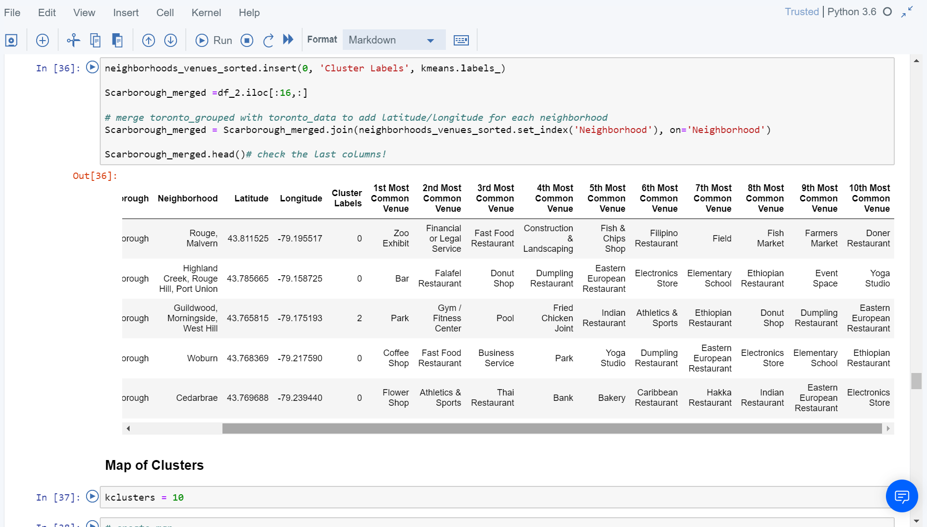
Methodology Section : Using K-Means Clustering Approach

Slide 6
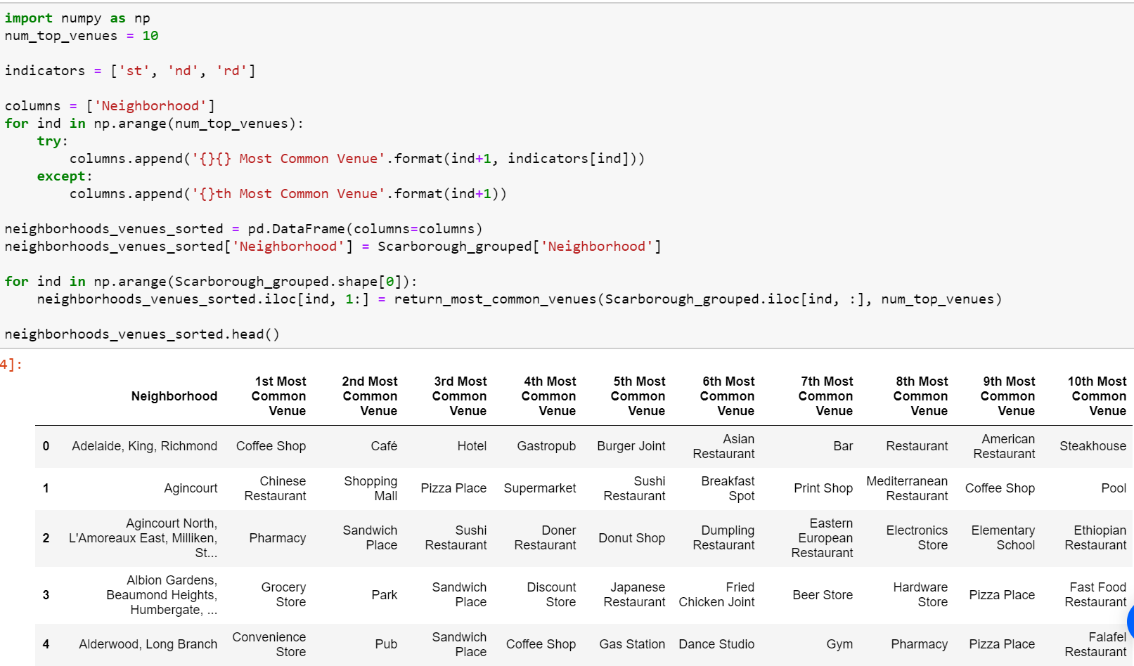
Most Common venues near Neighbourhood

Slide 7

Results Section

Slide 8
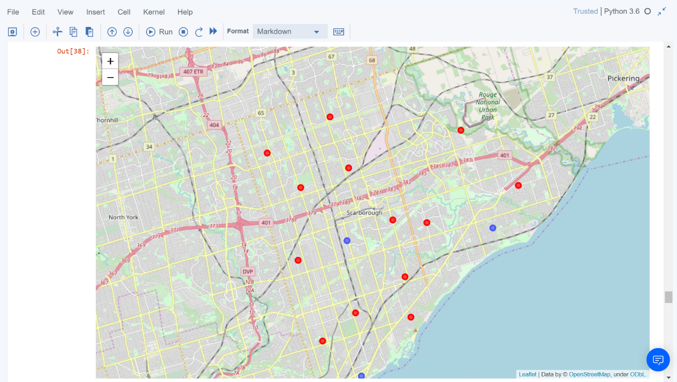
Map of Clusters in Scarborough

Slide 9

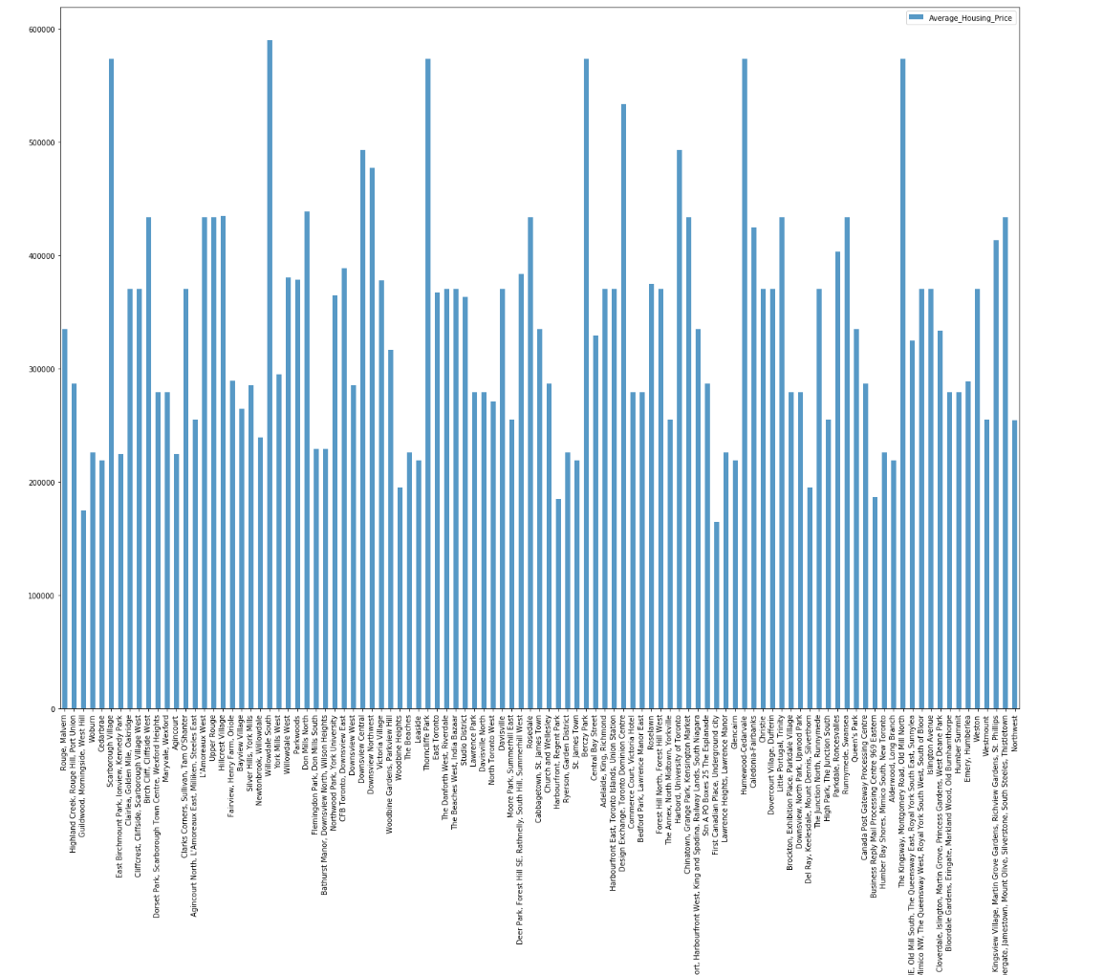
Average Housing Price by Clusters in Scarborough

Slide 10
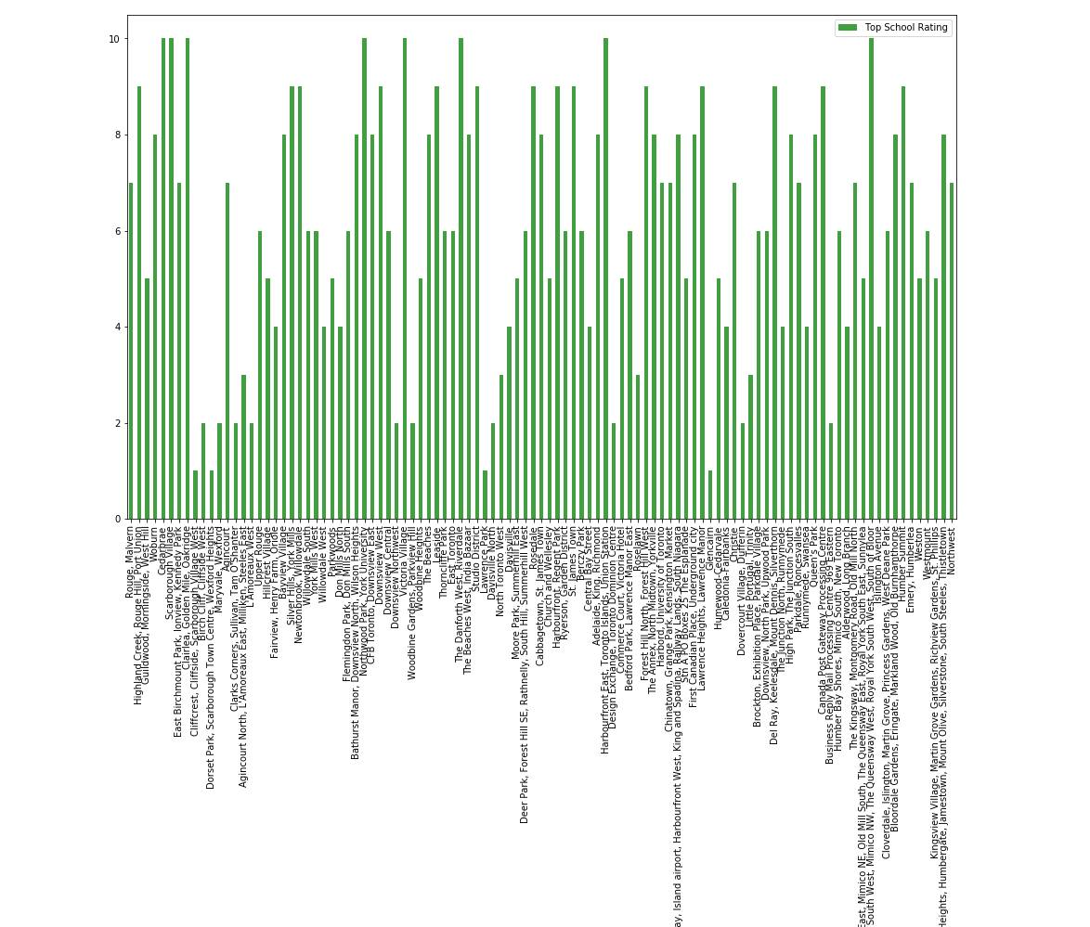
School Ratings by Clusters in Scarborough

Slide 11

Conclusion
In this project, using k-means cluster algorithm I separated the neighbourhood into 10(Ten) different clusters and for 103 different latitude and longitude from dataset, which have very-similar neighbourhoods around them. Using the charts above results presented to a particular neighbourhood based on average house prices and school rating have been made.
I feel rewarded with the efforts and believe this course with all the topics covered is well worthy of appreciation. This project has shown me a practical application to resolve a real situation that has impacting personal and financial impact using Data Science tools. The mapping with Folium is a very powerful technique to consolidate information and make the analysis and decision better with confidence.

Slide 12
Thank You

